Slide 1

October 27th, 2022
IROS 2022 Workshop on Assistive Robotic Systems for Human Balancing and Walking: Emerging trends and perspective
Equilivest: A Robotic Vest to aid in Post-Stroke Dynamic Balance Rehabilitation
Paviotti Franco¹, Buniak Esteban¹, Ramele Rodrigo¹, Orestes Freire², Santos Juan Miguel³
1 Instituto Tecnológico de Buenos Aires (ITBA), Buenos Aires, Argentina
2 Centro de Integral de Neurorehabilitación, Buenos Aires, Argentina
3 Universidad Nacional de Hurlingham, Buenos Aires, Argentina

Slide 2

Introduction
1/8
Cerebrovascular disease / Stroke
Main cause of disabilities worldwide [1]
After first six months of treatment most patients reach a steady state with slow improvements.
Patients who recover ability to walk
Falling or sudden balance lost is one of stroke’s most common secondary effects, impairing autonomy, independence, Activities of Daily Living (ADL).
Causes: dysmetria, feet sensation loss, proprioception issues, ataxic gait, bradykinesia, affected vestibular processing among many other reasons, every case being a unique situation.
Caplan 2022 [1], Donato 2016 [2]

Slide 3
Patient Case Study
1/8
36 years-old, healthy, female patient.
Acute brainstem stroke on posterior fossa subarachnoid after giving birth due to a brain artereovenous malformation (AVM) [3]
After 1-Month in induced coma, unable to walk, move, talk or swallow.
Throughout a first period of intensive rehabilitation, managed to recover significantly.
Discharged from hospital, 7 months after event.
Remaining affection is related to dynamic balance problems while walking.
Satisfactory index scores in static balance tests. Successful hip-balance, ankle-balance tests.
Recovered lower limbs strength.
Increase Risk of Falling: Walking on open spaces, confronting lights, concentration fades. Non-lateralized.
Able to walk with Canadian canes and under constant supervision
Current Treatment: Rehabilitation to retrain Vestibulo-Ocular Reflex (VOR).
Boseman 2015 [3]

Slide 4
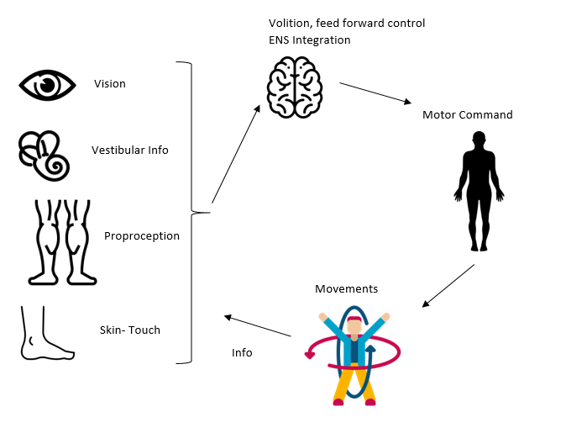
Human Dynamic Balance System
1/8
Donato 2016 [2]

Slide 5
Hypothetical Causes and Project Goals
1/8
Vestibular
Bradykinesia
Ataxic Gait
Project Goals
Wearable Actuated Vest: WDBR [3]
Testbed: iteratively improvements and testing.
VF: vibro-tactile feedback stimulation
Motor Control Learning: Assist-as-needed and adaptive VF signal [5]
Artificial
Vestibular
Feedback
Falling Risk
Awareness
System
Gait
Pacemaker
Peake 2018 [4], Balasubramanian 2010 [5]

Slide 6
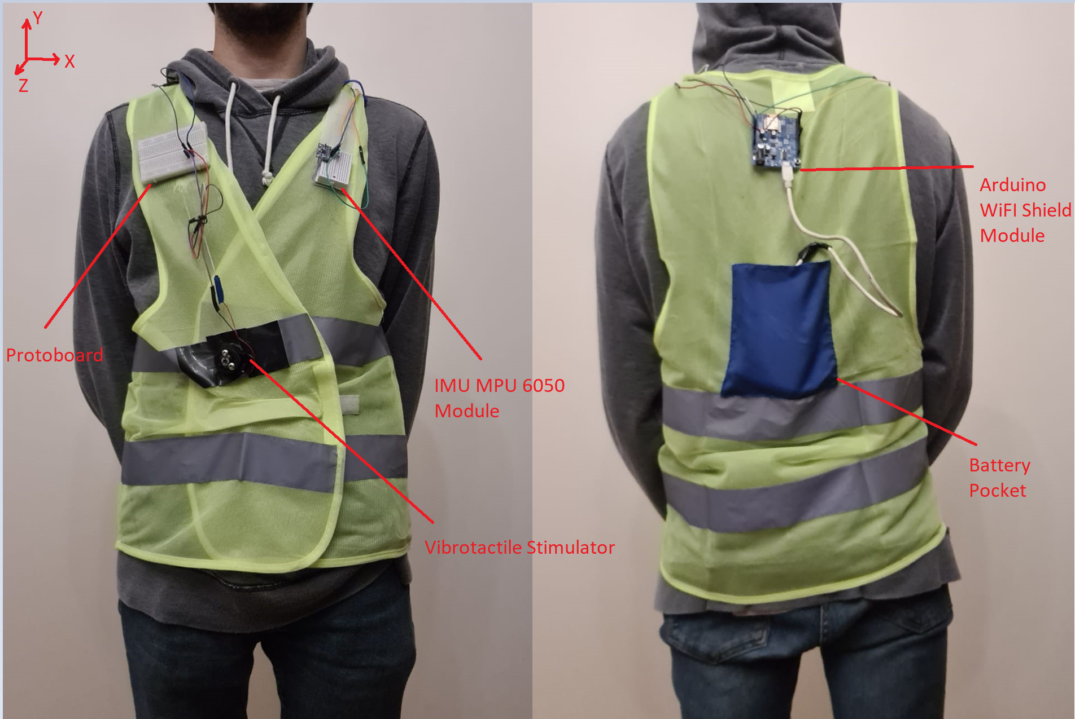
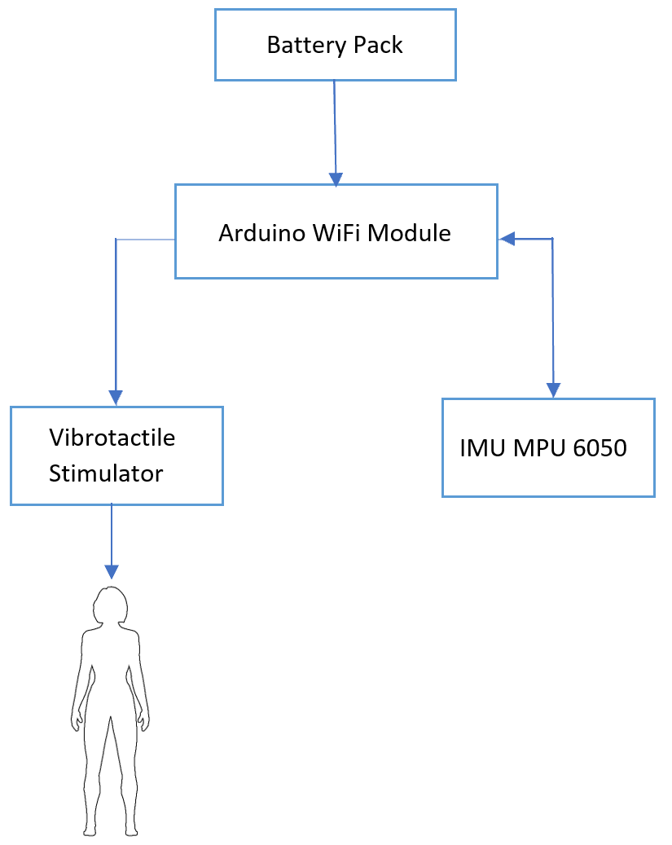
Equilivest
1/8

Slide 7
Experiments
1/8
Experiments
Vestibular Information Integration: Participants are told to lean forward performing ankle forward until they can’t maintain balance anymore Goal: Determine breaking point before falling
Ataxic Gait: Ten-Meter Walking (10MWT) assessment Goal: Identify gait abnormalities, steps occurring and falls
Bradykinesia: Combination of previous two experiments Goal: Analyze whole process and phenomenon
Video con graficos

Slide 8
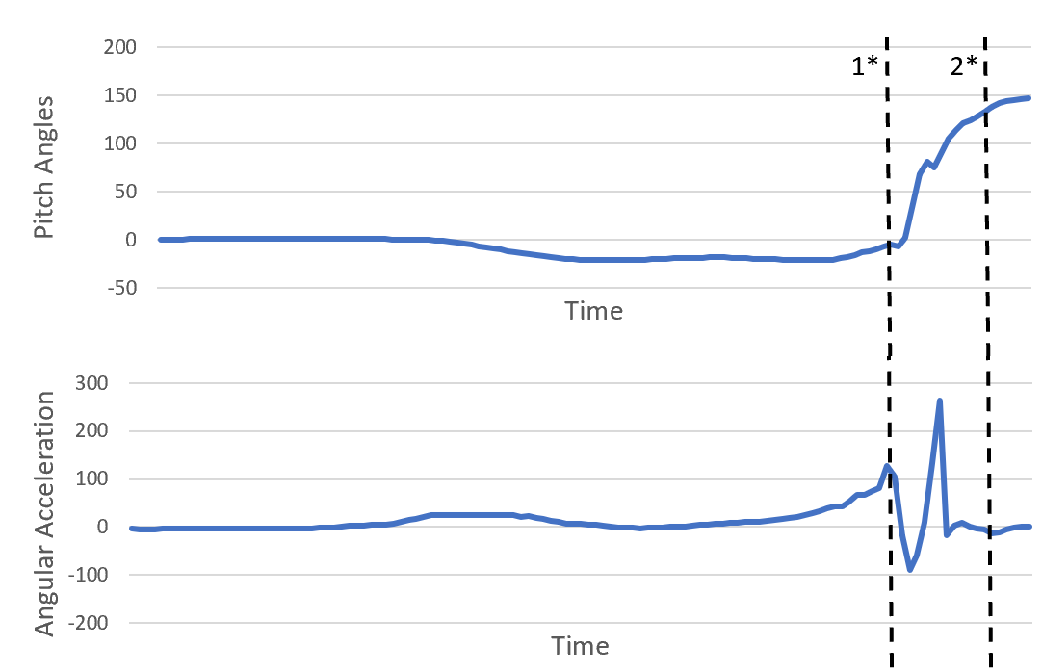
Experiments
Experiments
Vestibular Information Integration: Participants are told to lean forward performing ankle forward until they can’t maintain balance anymore Goal: Determine breaking point before falling
Ataxic Gait: Ten-Meter Walking (10MWT) assessment Goal: Identify gait abnormalities, steps occurring and falls
Bradykinesia: Combination of previous two experiments Goal: Analyze whole process and phenomenon

Slide 9
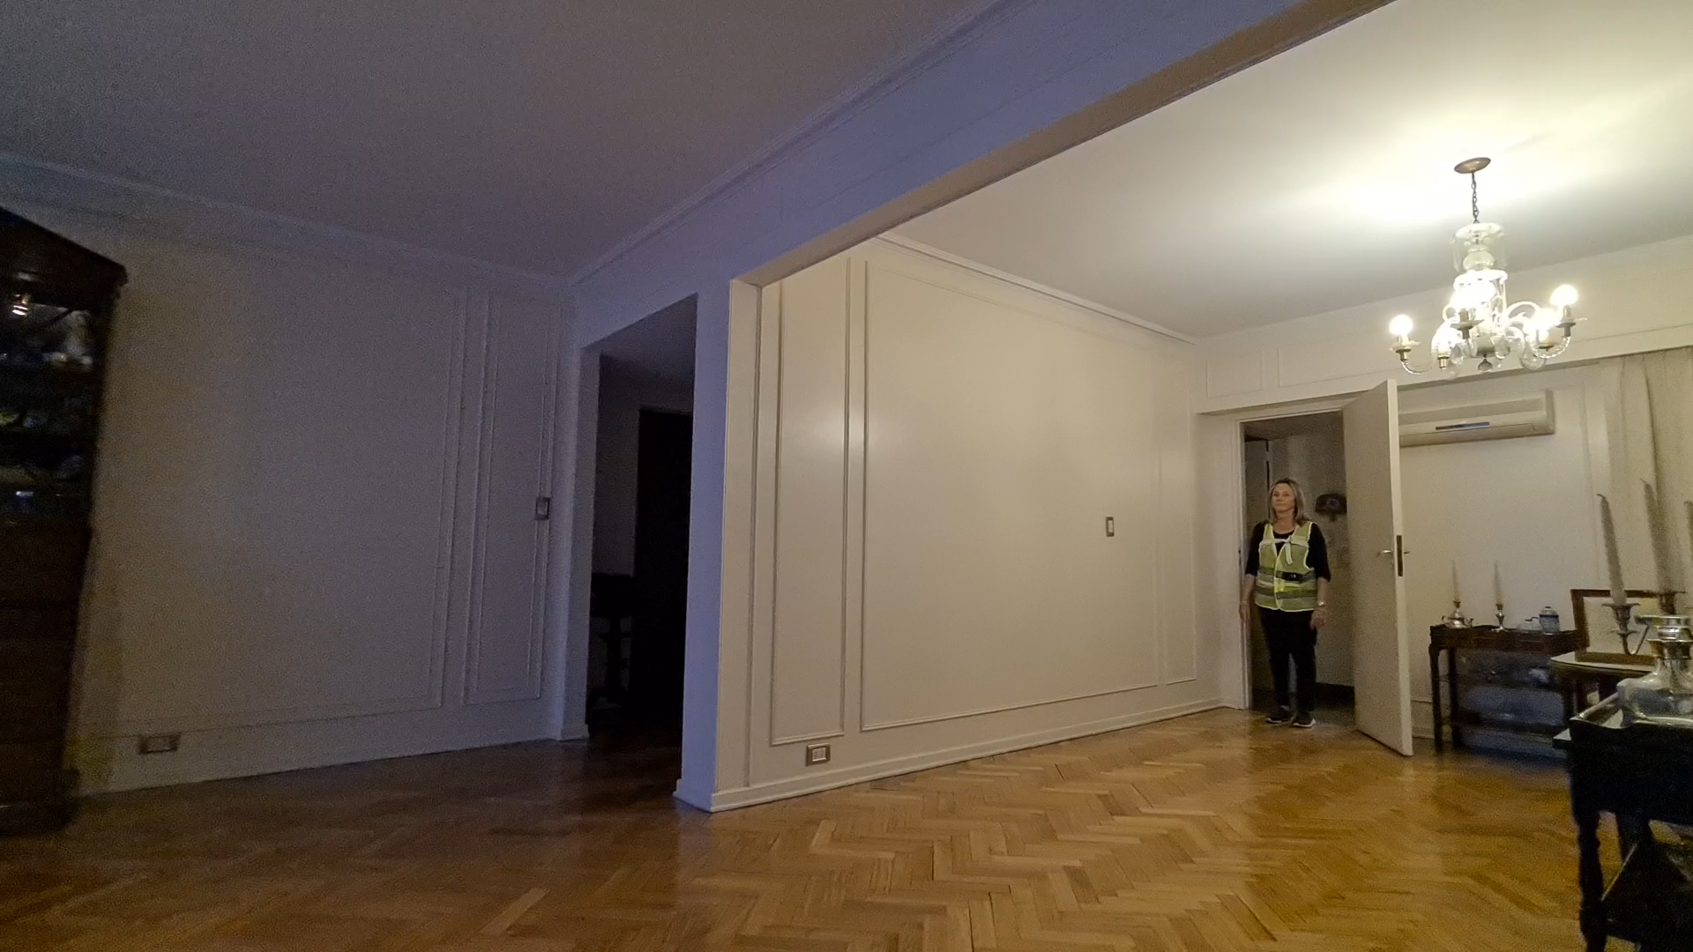
Results

Slide 10
Results
1/8
Presentar mas resultados

Slide 11
Work in progress
1/8
Patient vest trials will begin next week concurrently on Motion Capture
IMU on headsets
Visual feedback
Further tunning and mapping once feedback is provided

Slide 12
References
1/8
[1] L.R.Caplan,R.P.Simon,andS.Hassani,“Chapter27-cerebrovascular disease—stroke,” in Neurobiology of Brain Disorders (Second Edition), M. J. Zigmond, C. A. Wiley, and M.-F. Chesselet, Eds. Academic Press, 2023, pp. 457–476. [2] S. M. Donato, K. H. Pulaski, and G. Gillen, “Chapter 19 - overview of balance impairments: Functional implications,” [22] in Stroke Rehabilitation (Fourth Edition), fourth edition ed., G. Gillen, Ed. Mosby, 2016, pp. 394–415.
[3] Boseman, T., Orman, G., Boltshauser, E., Tekes, A., Huisman, T. A. G. M., & Poretti, A. (2015). Congenital abnormalities of the posterior fossa. Radiographics, 35(1), 200–220. https://doi.org/10.1148/rg.351140038
[4] J. M. Peake, G. Kerr, and J. P. Sullivan, “A critical review of consumer wearables, mobile applications, and equipment for providing biofeedback, monitoring stress, and sleep in physically active populations,” Frontiers in physiology, vol. 9, p. 743, 2018.
[5] S.Balasubramanian,H.Zhang,S.Buchanan,H.Austin,R.Herman,and J. He, “Cooperative and active assistance based interactive therapy,” in IEEE/ICME International Conference on Complex Medical Engineering. IEEE, 2010, pp. 311–315.

